Slide 1
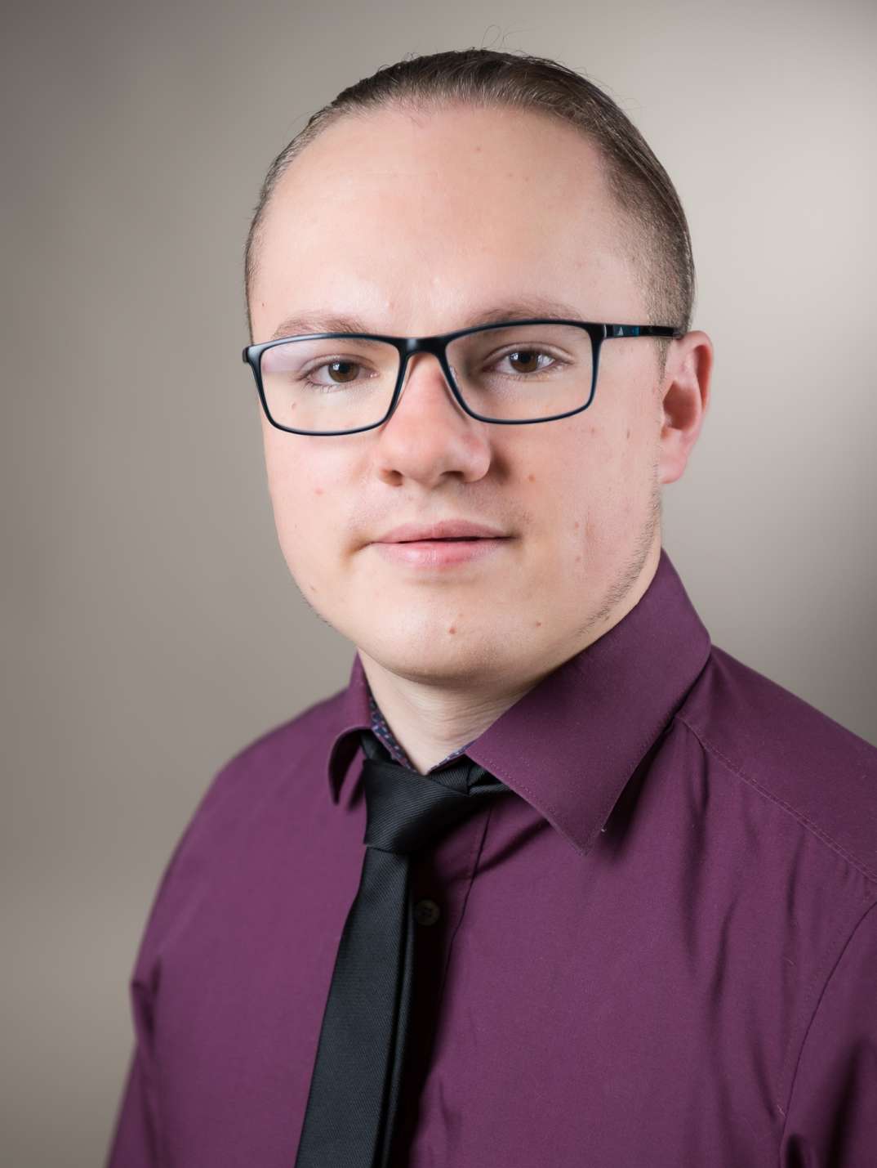
Marcel Öfele
current Semester: 2nd semester Digital Engineering
Past Studies: B.Eng. Mechanical Engineering
Skills:
minor experience with SCRUM
1 year of experience as project leader
programming skills: java, python
Personal Motivation
learning more about Software Development in general
learning more about agile methods
applying programming skills

Slide 2
For Blog
I am interested in Software Engineering because I think this is a very important topic for anybody who is working in the field of computer science. I hope I can learn methods how to handle projects in a agile way and I am also keen on solidifying and applying my programming skills.

